Slide 1
SELNIUM AUTOMATION & DOCKER IMPLIMENTATION PROJECT
Name : Harika Burna
Employee.ID : 201452
E-mail : Harika.Burna@amdocs.com

Slide 2
CONTENTS
Selenium
Spring Boot Initializer
Docker

Slide 3
INTRODUCTION
Selenium :
→ Selenium is an open-source, automated testing tool used to test web applications across various browsers.
→ Selenium was originally developed by Jason Huggins in 2004
→ Selenium supports multiple Operating Systems and also multiple programming language.
→ Selenium web driver is most popular in Java and C#
Docker :
→ Docker is a software platform that allows you to build, test, and deploy applications quickly.
→ Docker packages software into standardized units called containers that have everything the software needs to run including libraries, system tools, code, and runtime.

Slide 4
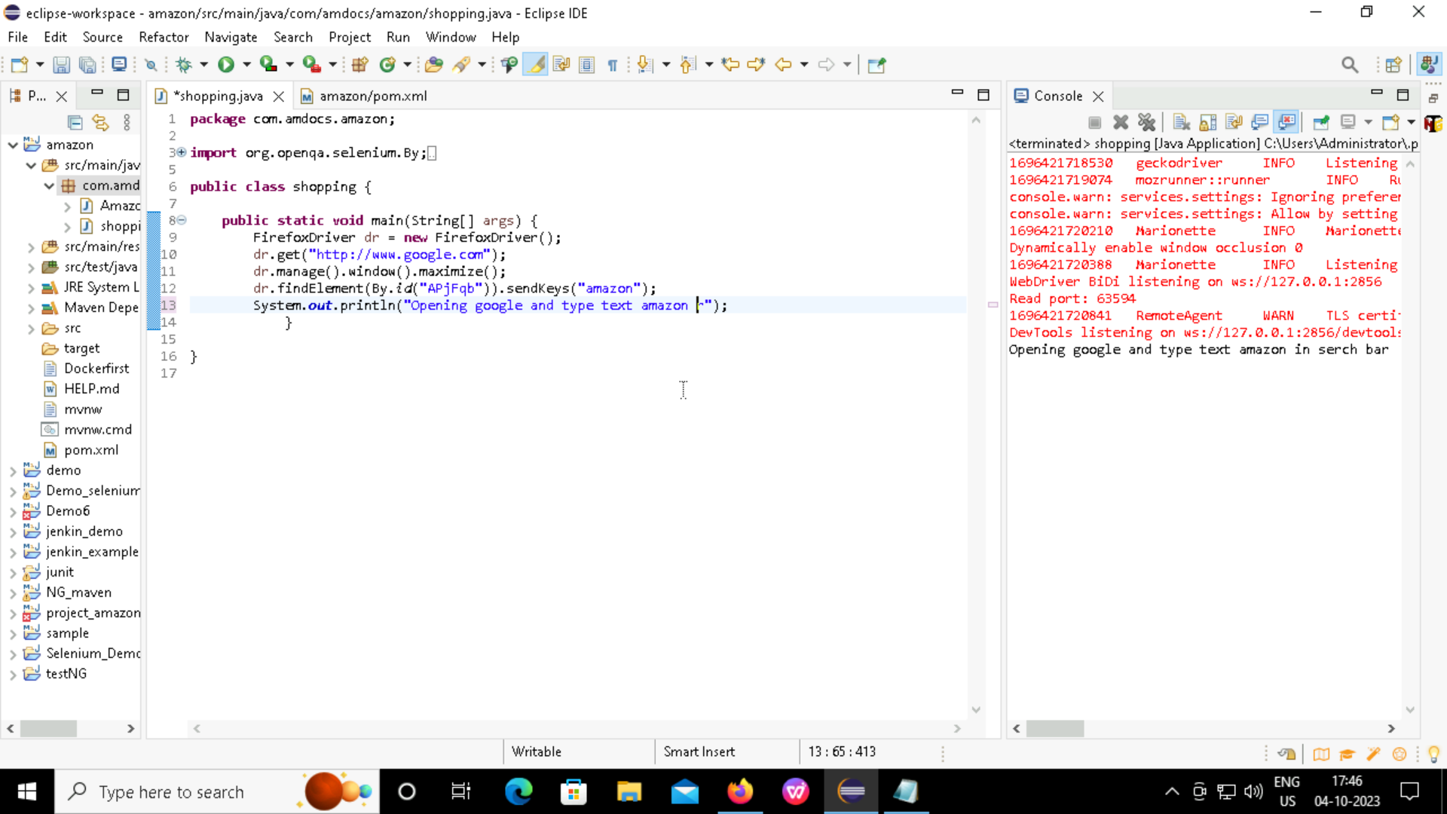
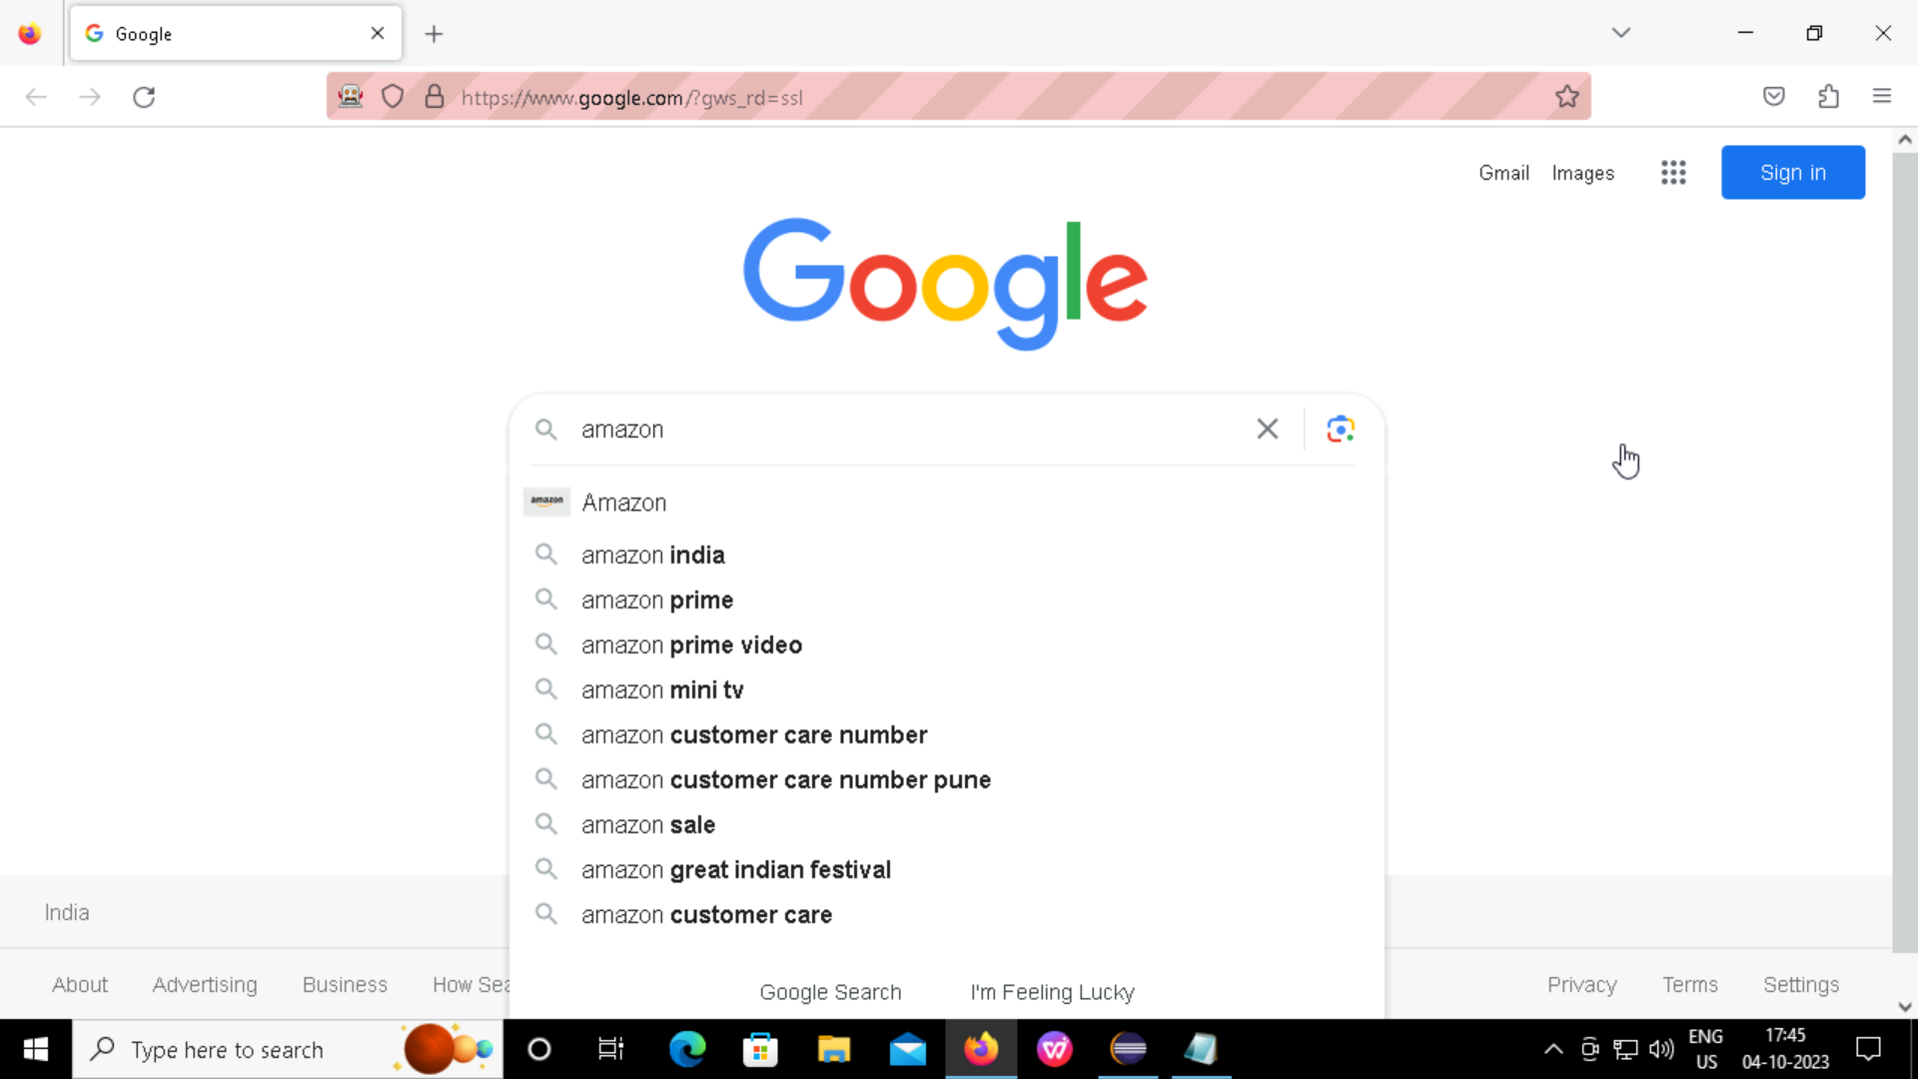
AUTOMATION USING SELENIUM TOOL
Importing Web Drivers and implementing simple google website
Code : Output :

Slide 5
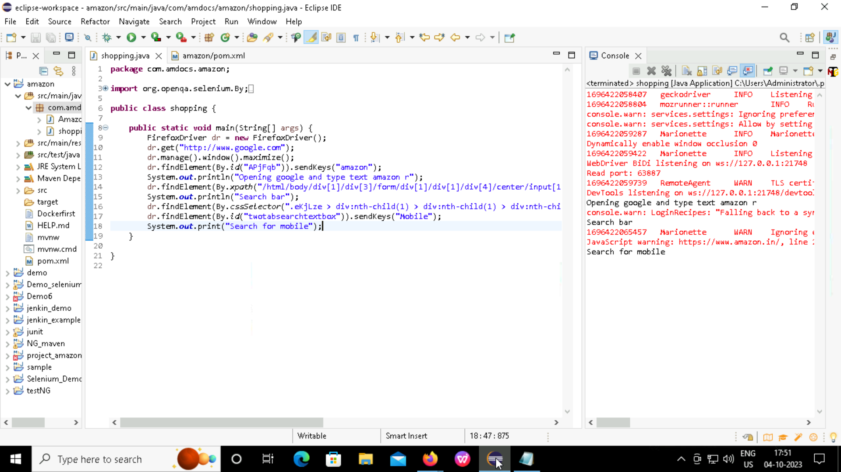
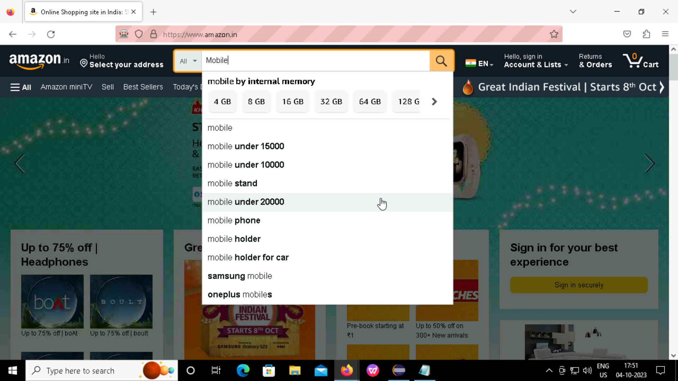
Searching for item in amazon website
Code : Output :

Slide 6
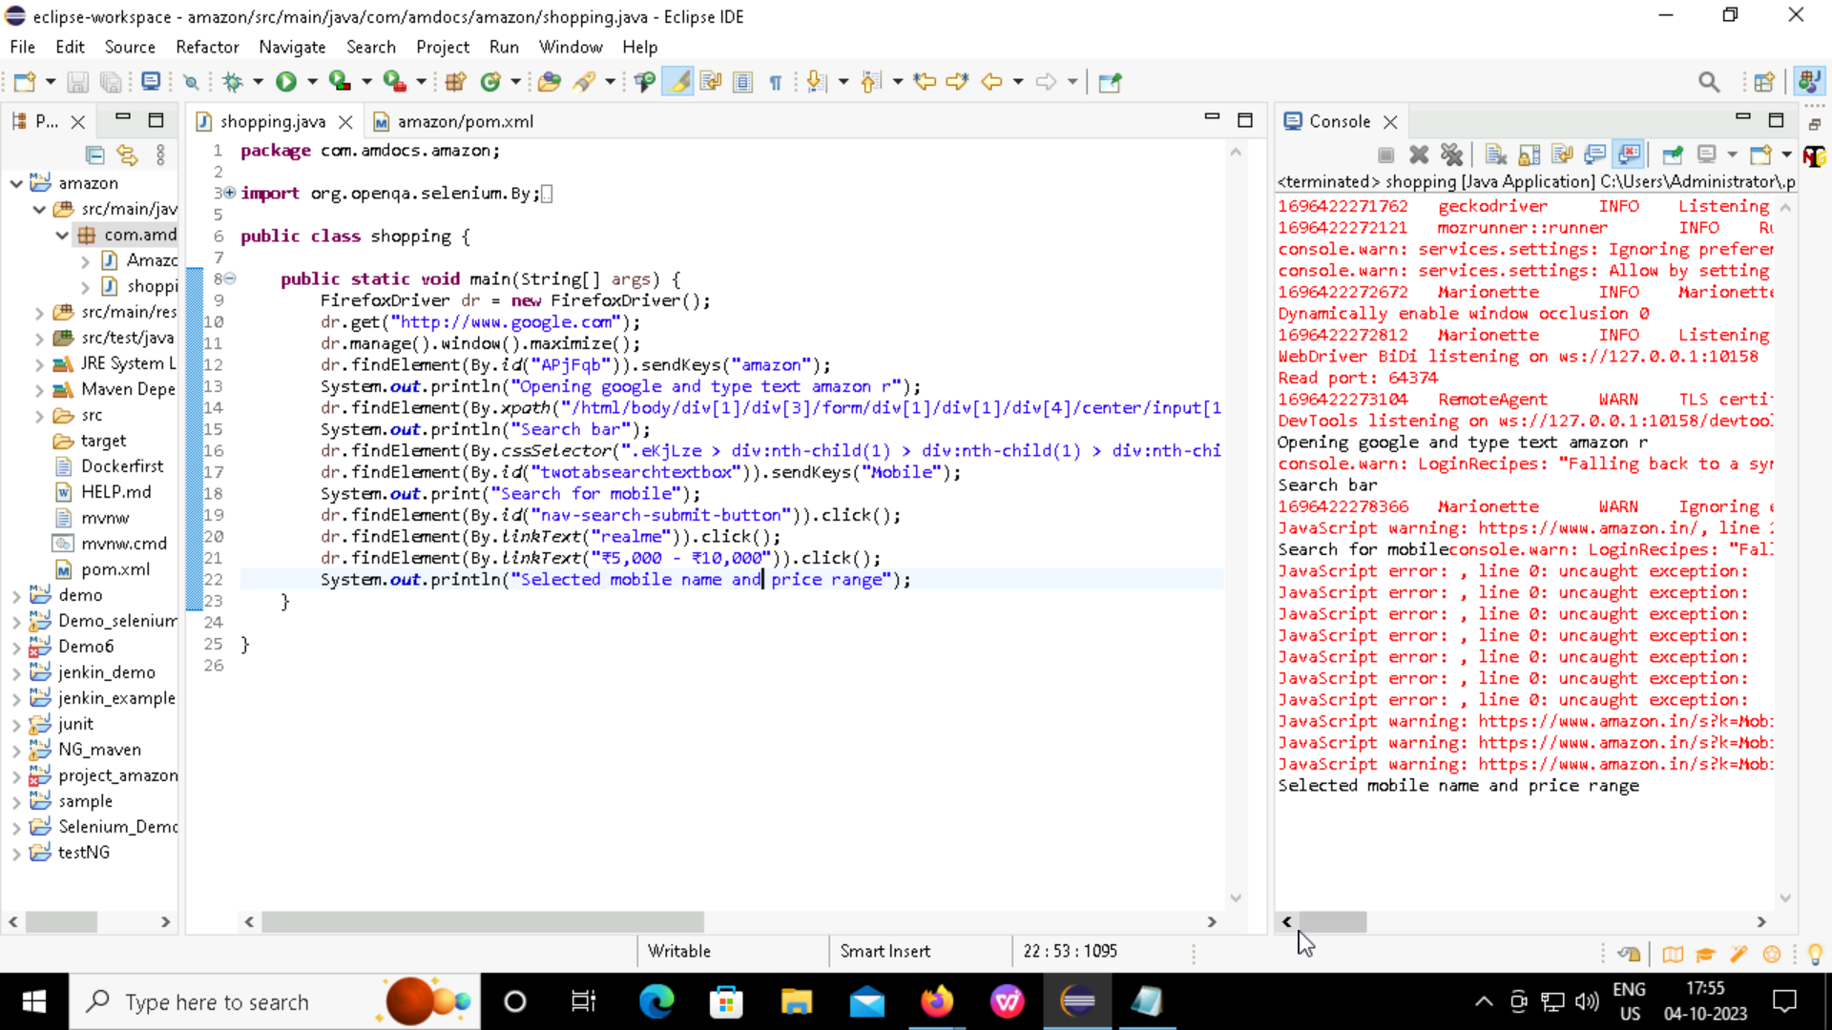
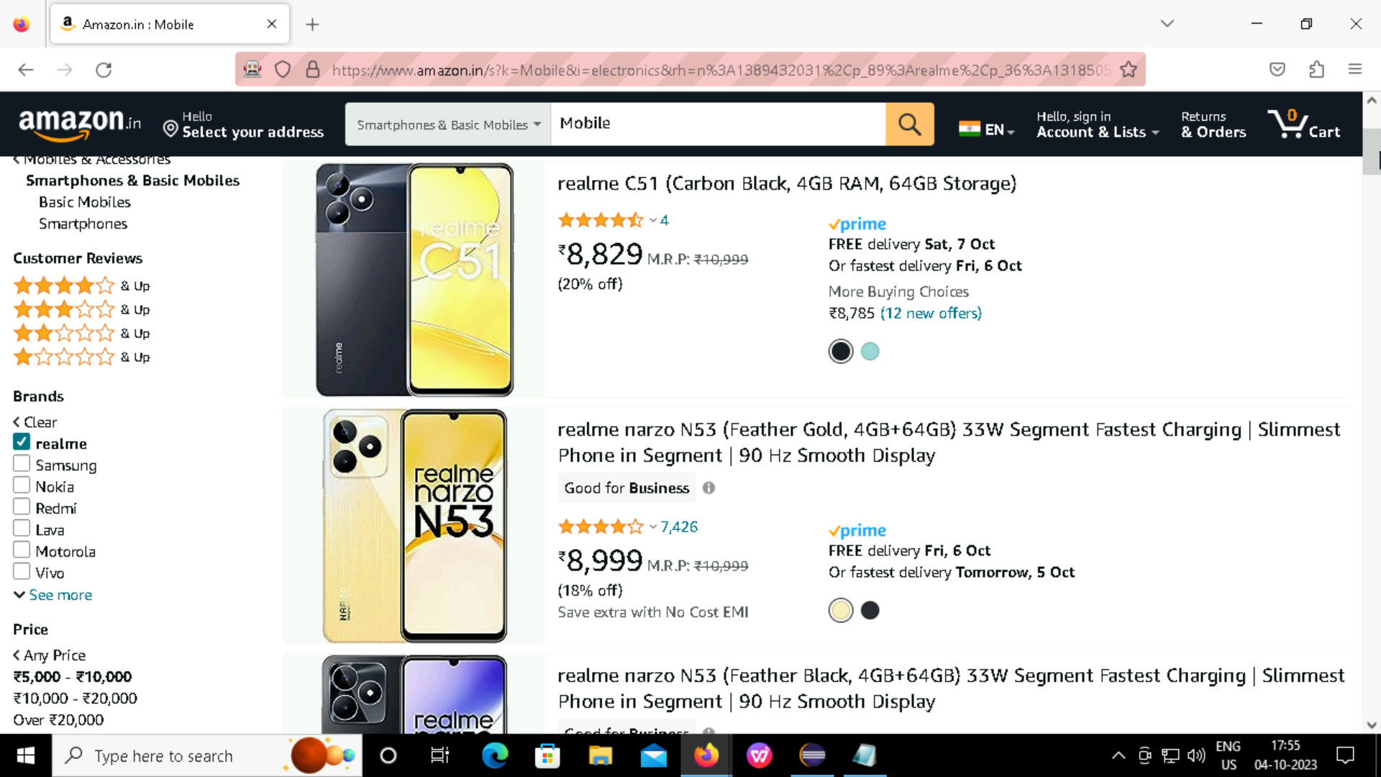
Adding filters for the sort the items
Code : Output :

Slide 7
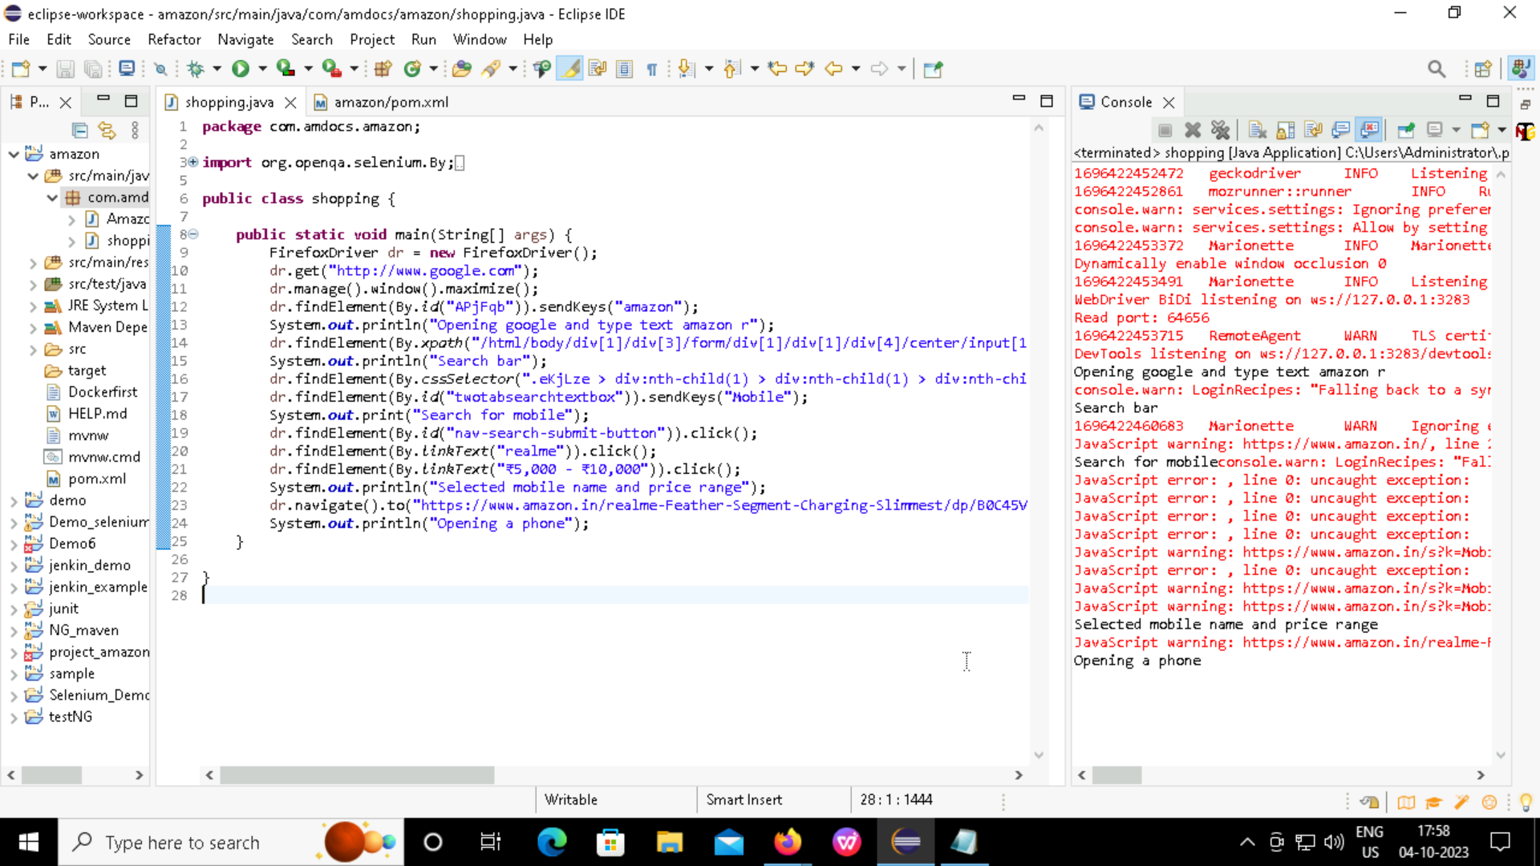
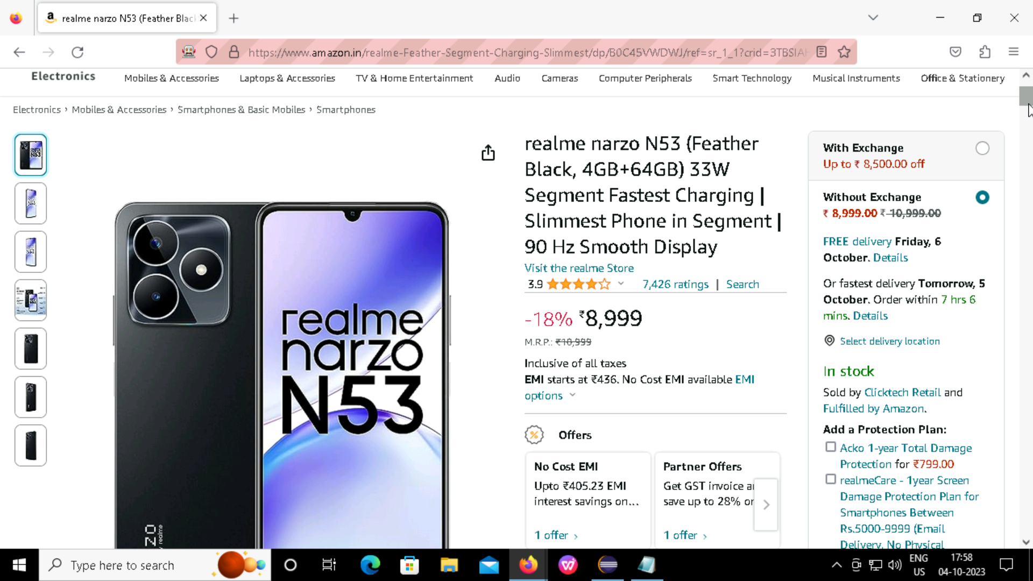
Selecting a item from list
Code : Output :

Slide 8
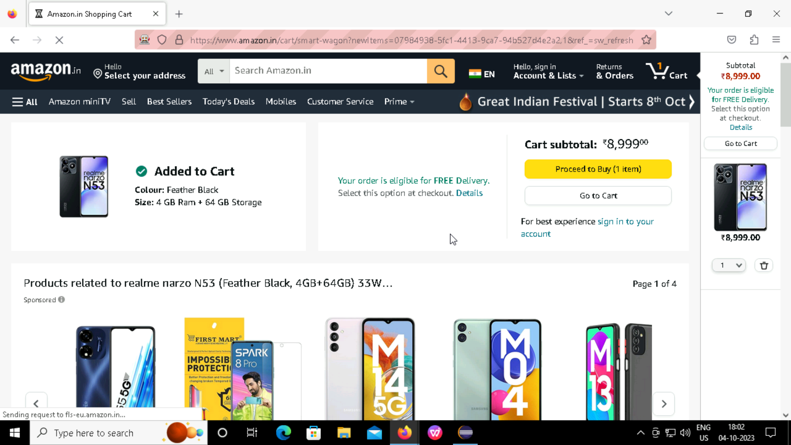
Adding the item to the cart
Code : Output :

Slide 9
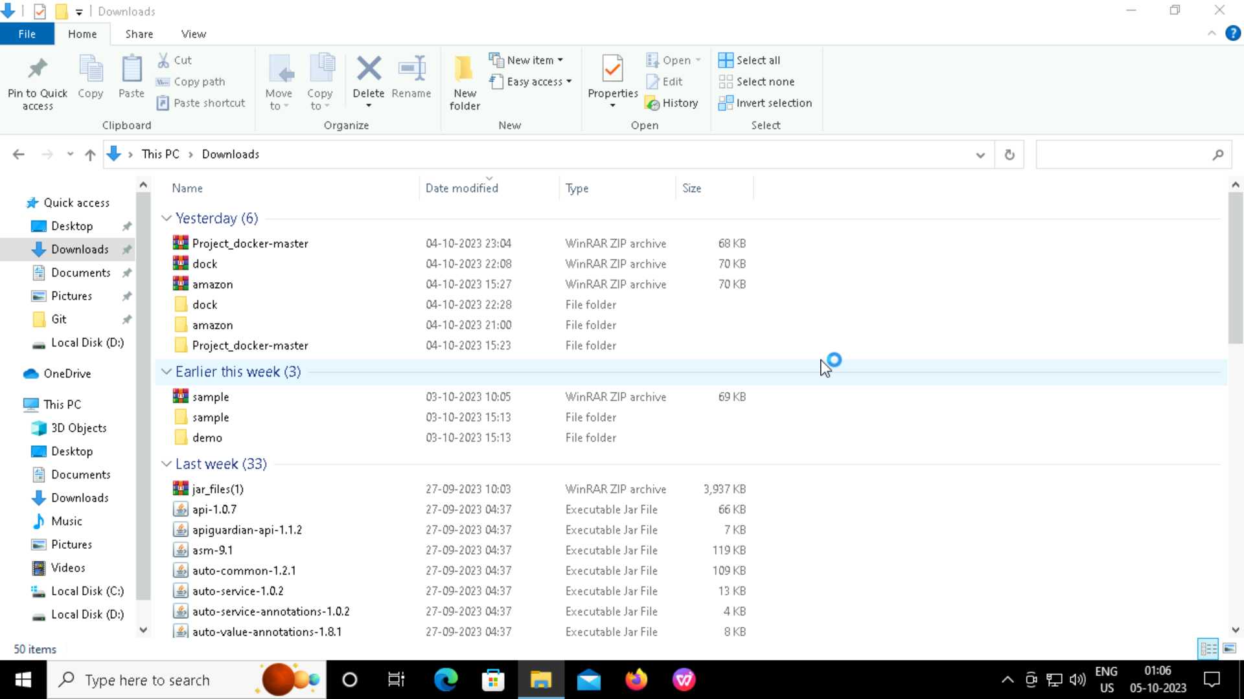
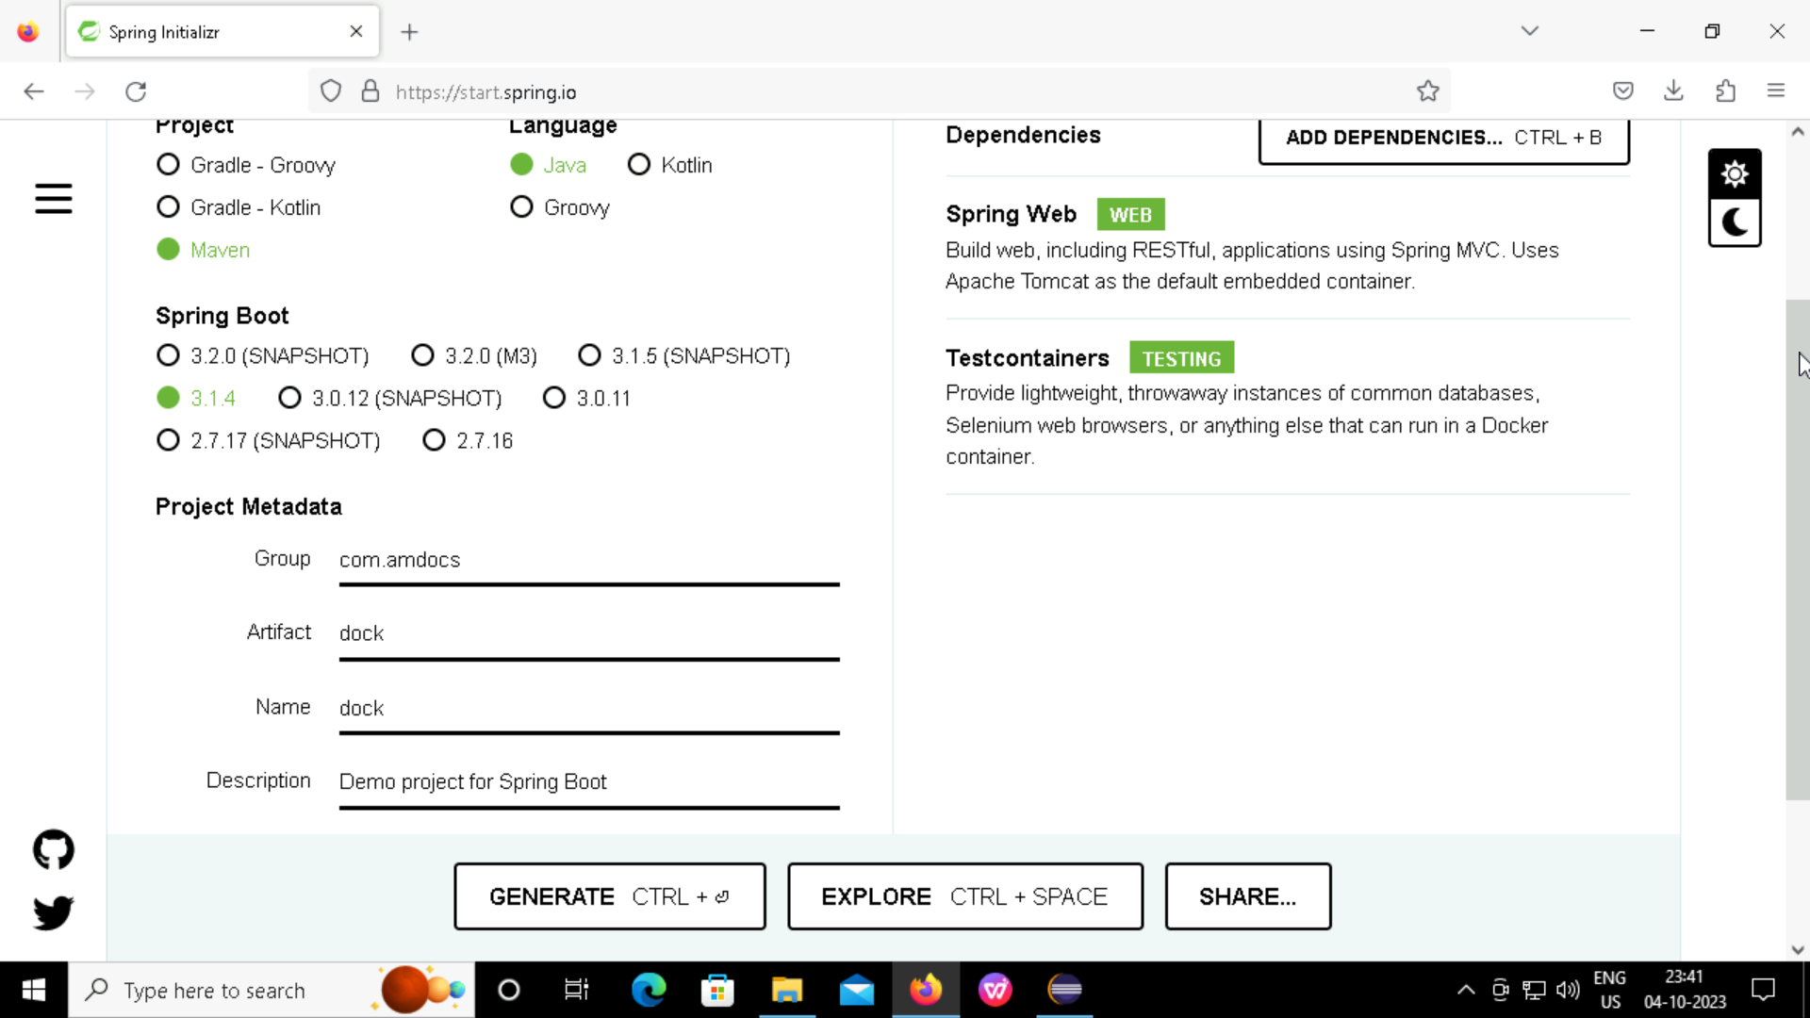
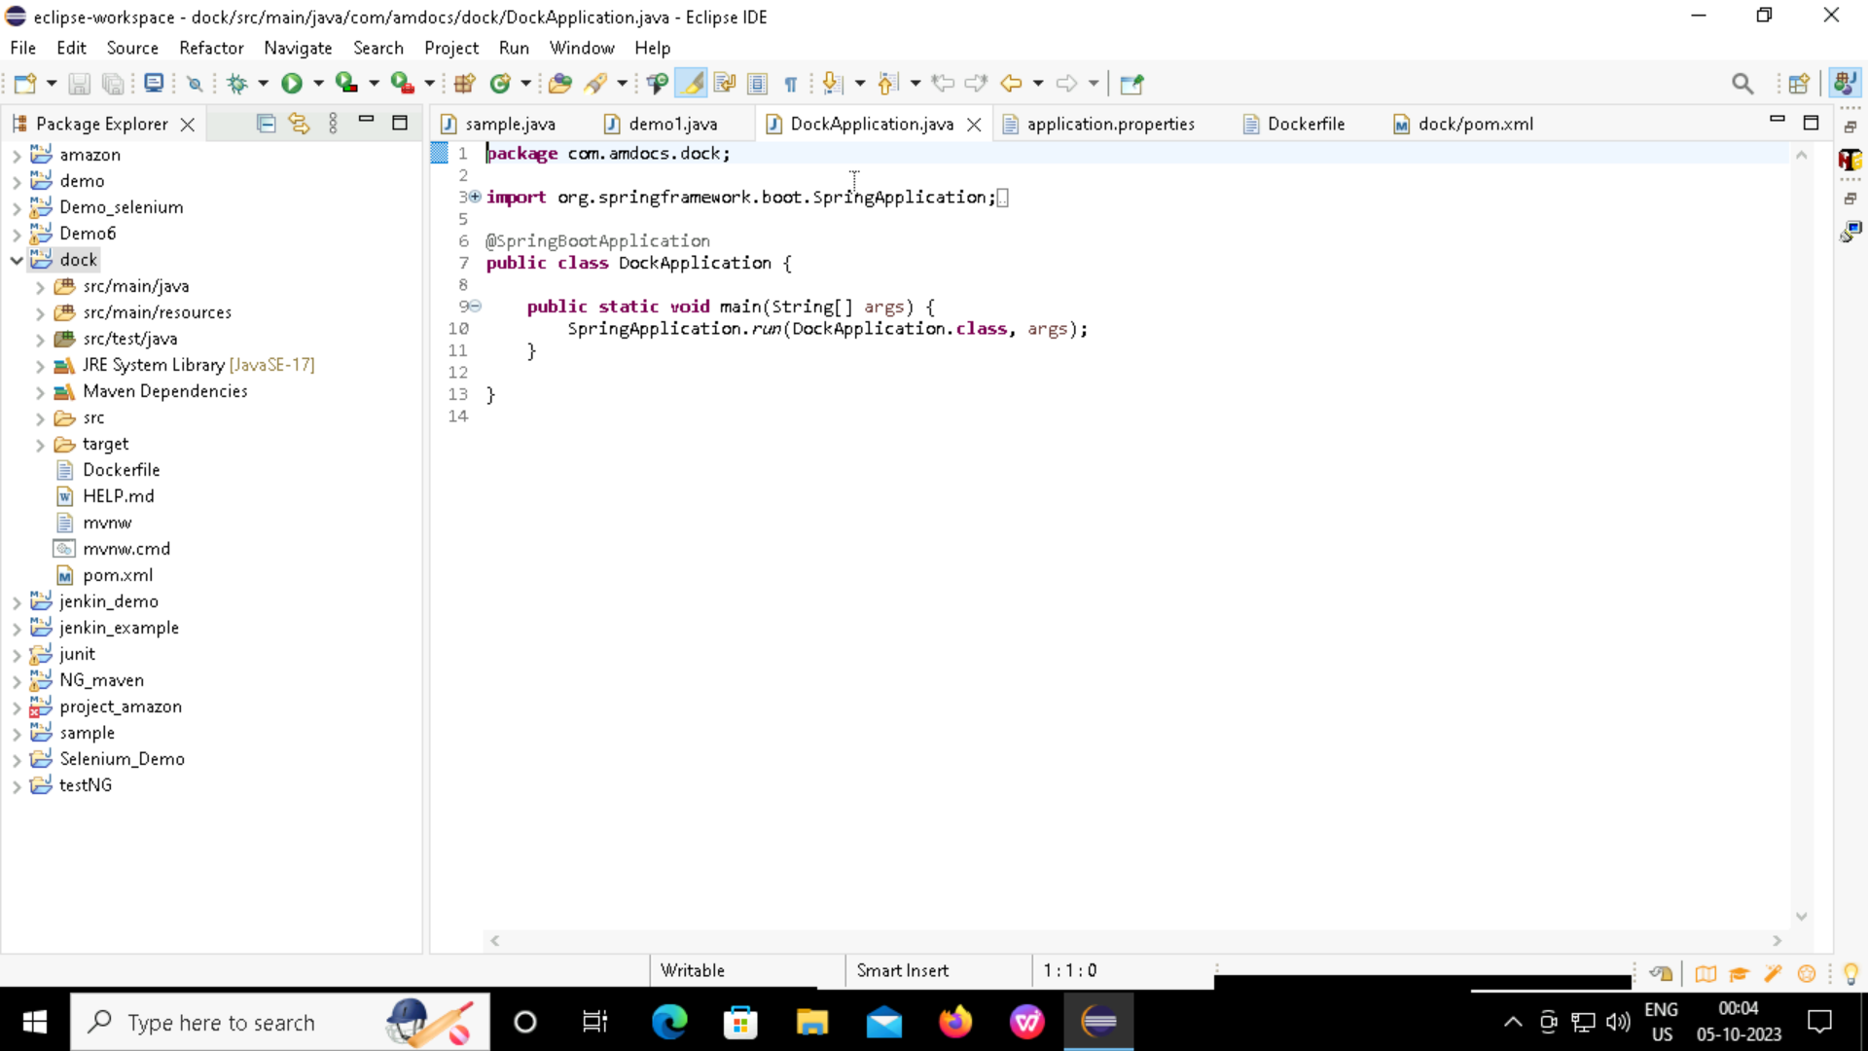
DOCKER Creation of a simple spring boot project for Dockerization

Slide 10
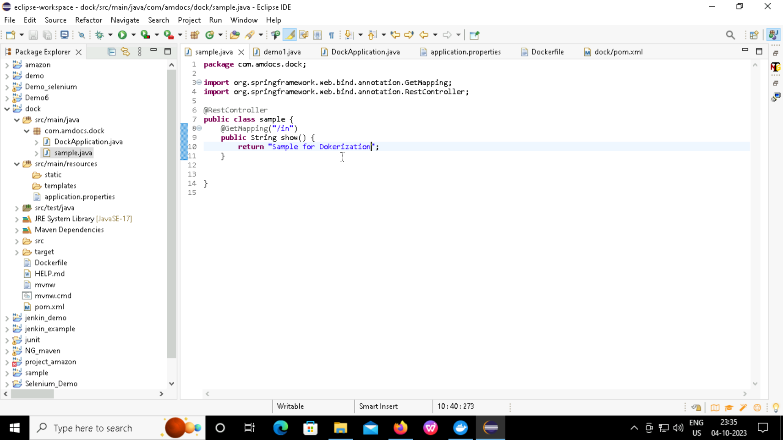
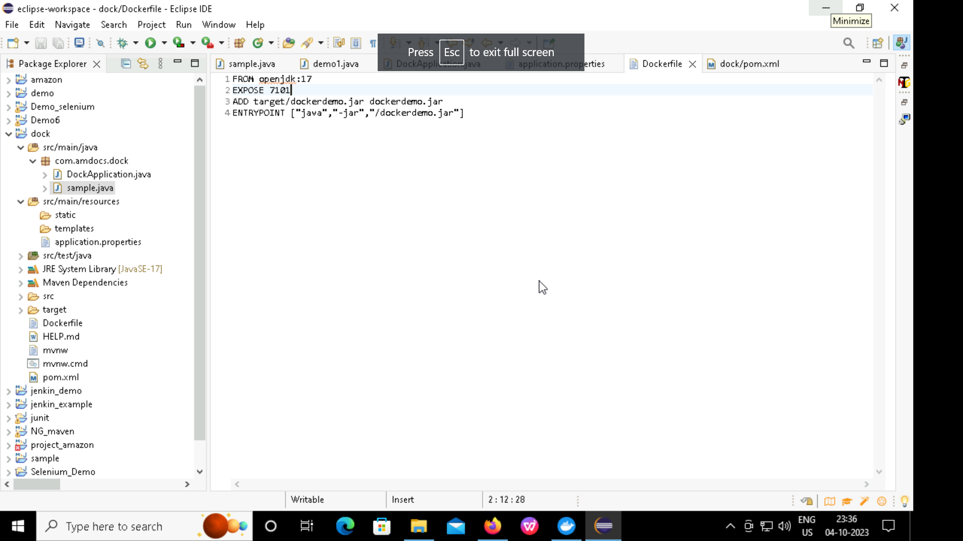
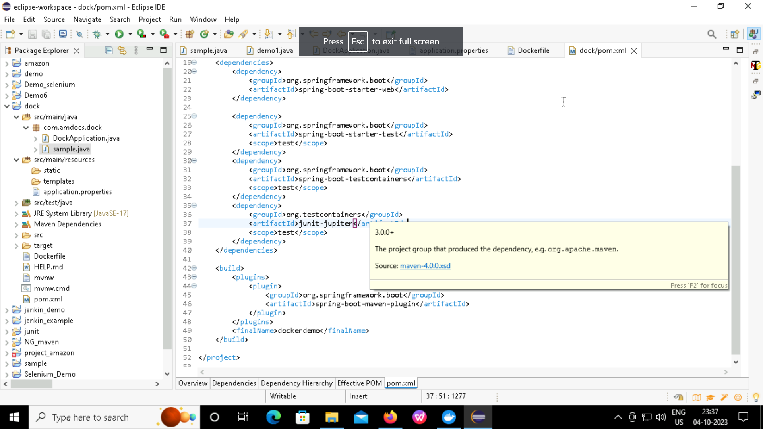
Docker Implementation
Docker file :
Creating a class in the package
Adding jar file name :

Slide 11
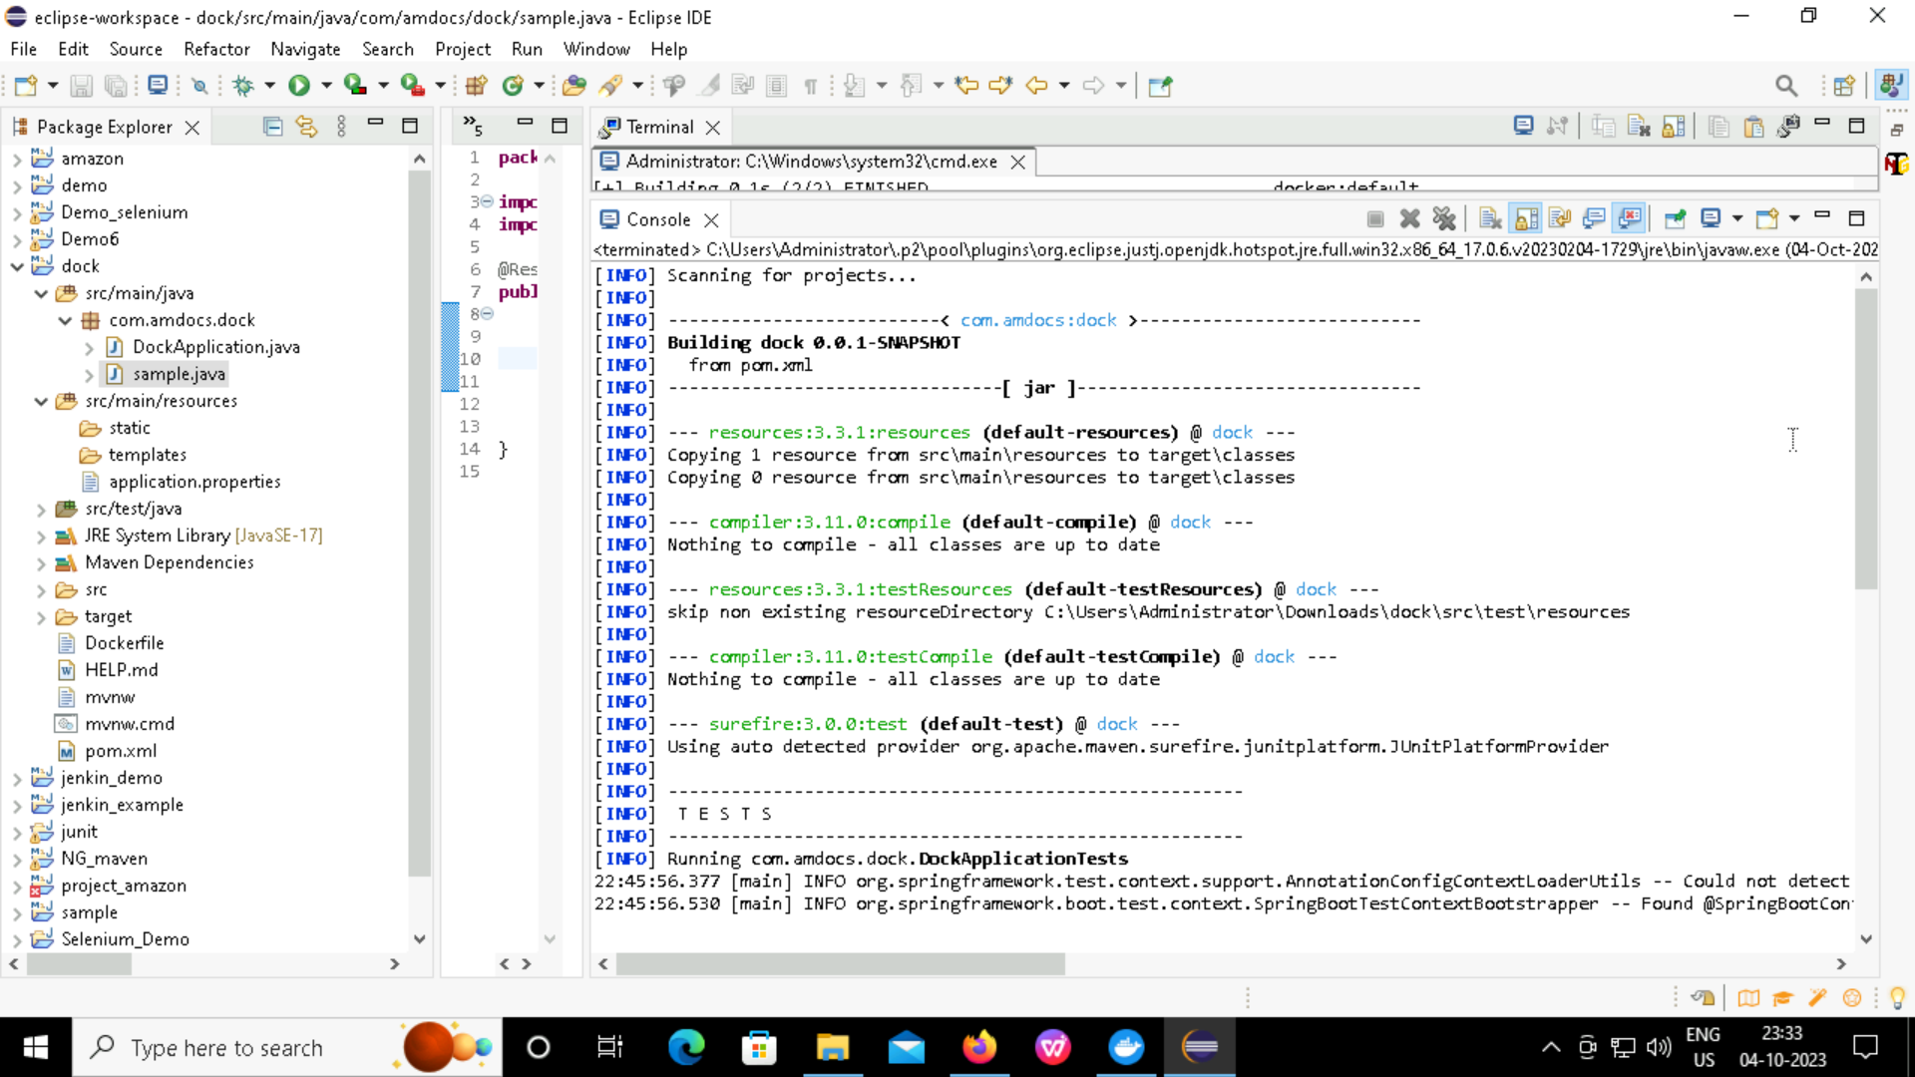
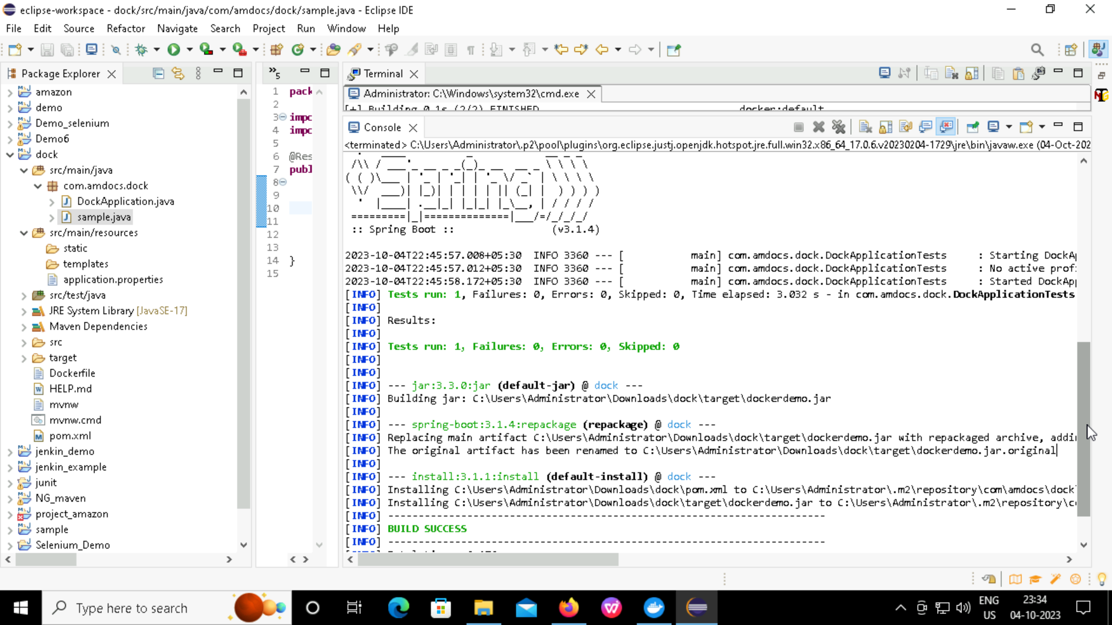
Creating JAR file
Project →Right click → Run as → Maven Install

Slide 12
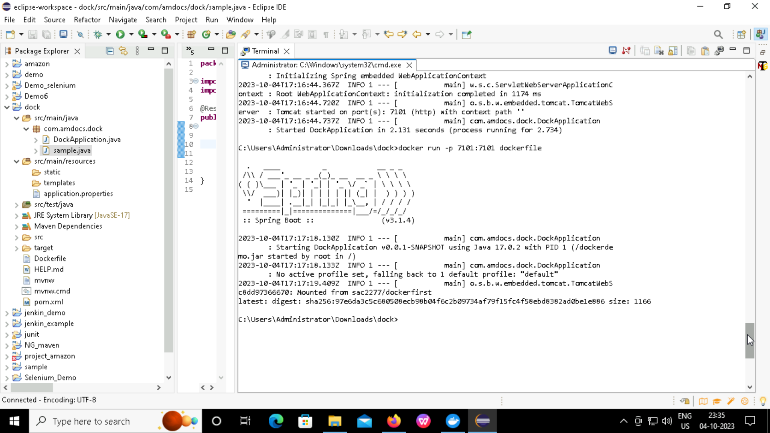
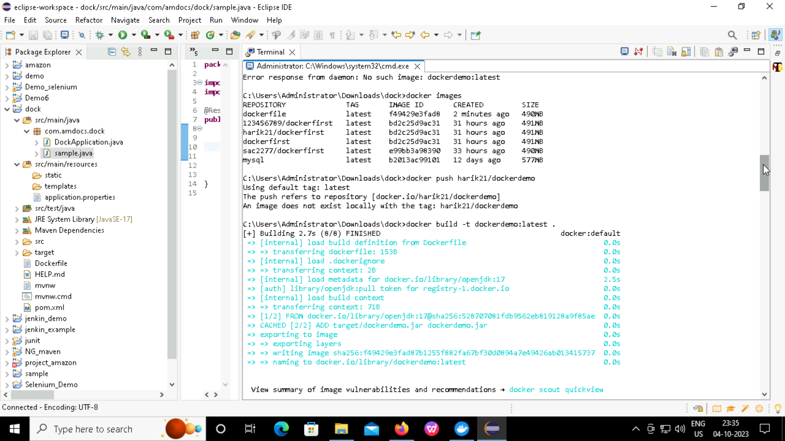
Implementing docker commands for dockerization

Slide 13
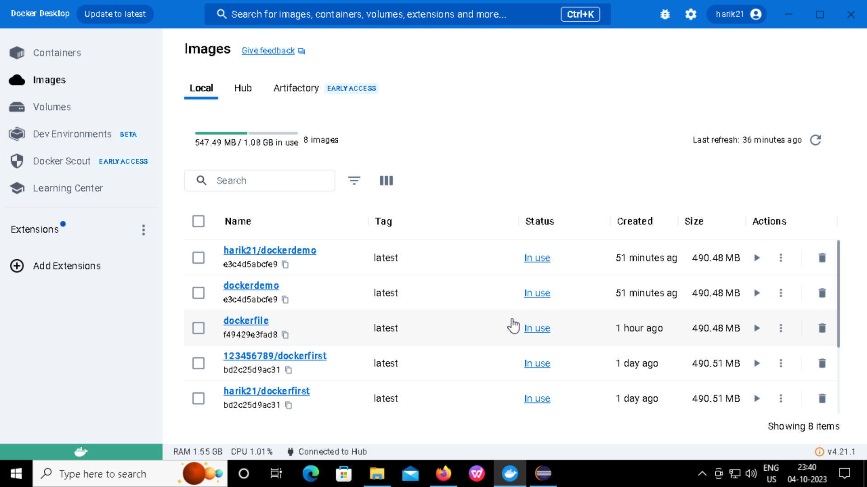
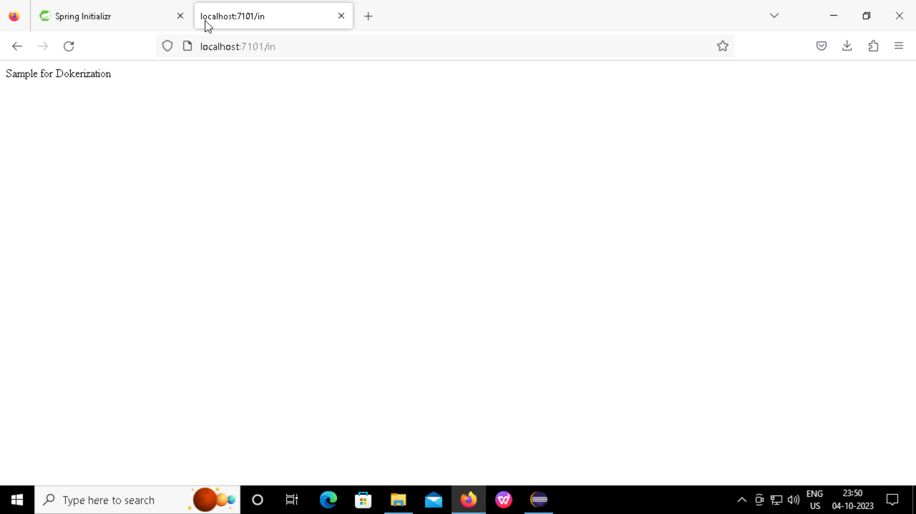
Output

Slide 14
THANK YOU

